Slide 1
Automotive Electronics and Development Process (V Model)

Slide 2
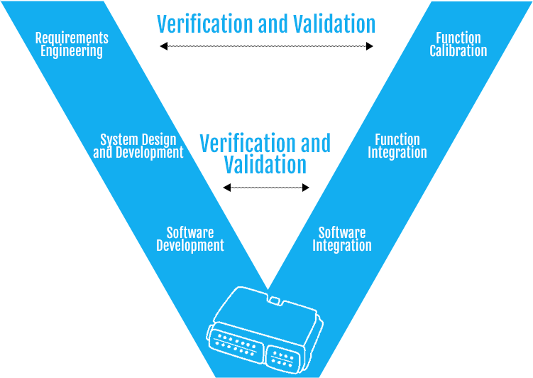
What is V model?
Requirement analysis
Design and
Development
Verification and validation

Slide 3
V-Model (where V stands for verification and validation) splits the development process into two parts – the left arm of the V consists of requirement analysis, function design, and software development while the right arm concentrates on the verification and validation activities followed by the release.

Slide 4
Electronics system in automotive
The role of electronic systems in the automotive industry is continuously expanding.
As the number of electronic functions increases, so do the number of ECUs in the vehicle.
This increase in ECUs and electronic functions results in the associated software becoming more complex and expansive.

Slide 5
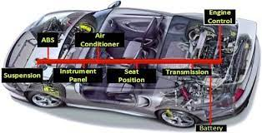

Slide 6
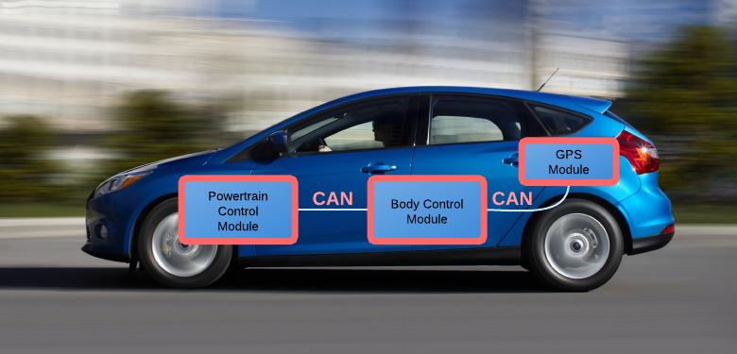

Slide 7
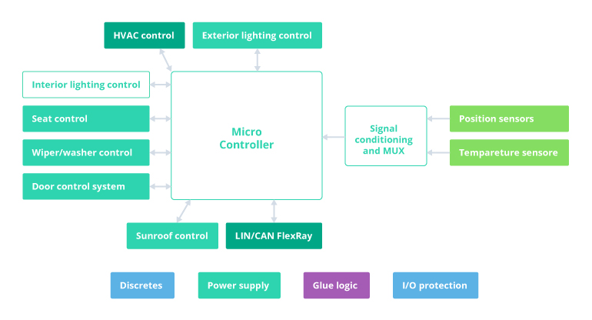
General representation of a body control module

Slide 8
What are body control module functions?
A BCM in automotive can perform a wide range of functions. Output devices are managed based on data received from input devices via CAN (Controller Area Network), LIN (Local Interconnect Network), or Ethernet as the means of communication with modules and systems. Electronic systems that can be integrated and controlled via a BCM include:
Energy management systems
Alarms
Immobilizers
Access/driver authorization systems
Advanced driver assistance systems
Power windows

Slide 9
A BCM can perform multiple control-related operations simultaneously. One of the major objectives of this module is to detect malfunctions in the work of electrical system components. Integral body control module features include:
Ensuring safety, testing, and control of crucial electrical loads, including lights, immobilizers, air conditioning systems, locking systems, and windscreen wipers
Maintaining communication between integrated control units via the vehicle bus system (CAN, LIN, or Ethernet)
Working as an integration gateway
Providing a user-friendly interface for complex data management

Slide 10
Using BCM in automotive electronics is challenging. But it’s also remarkably beneficial

Slide 11
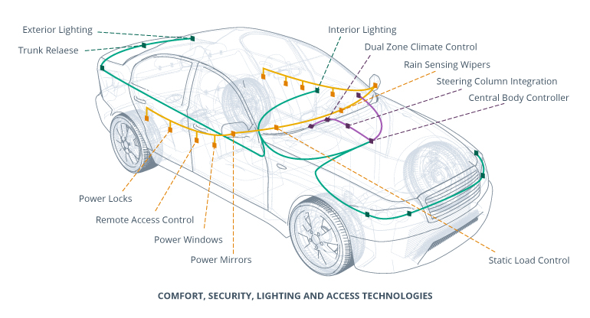

Slide 12
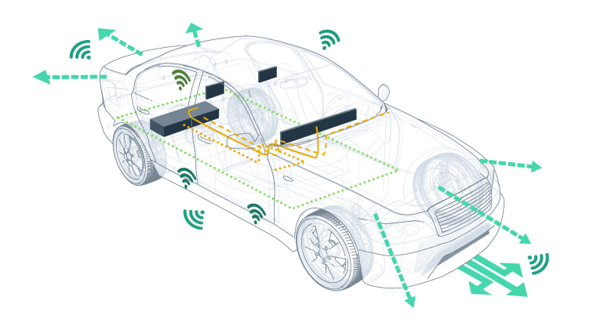
ECU network in modern automobiles

Slide 13
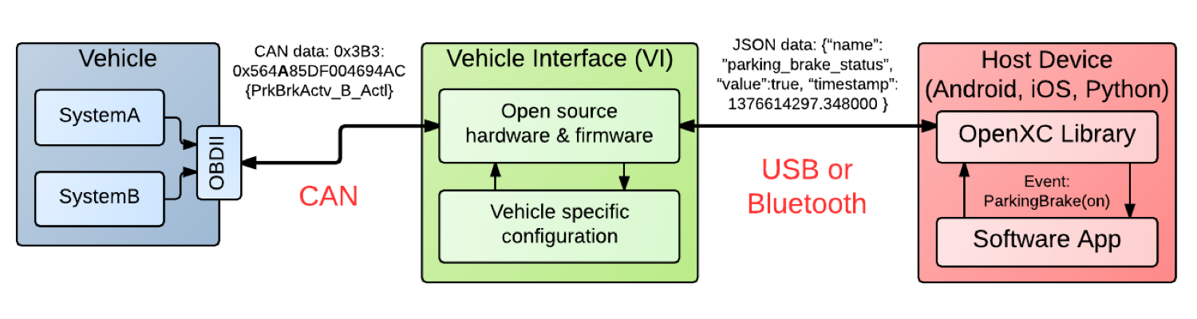
Communication on CAN

Slide 14
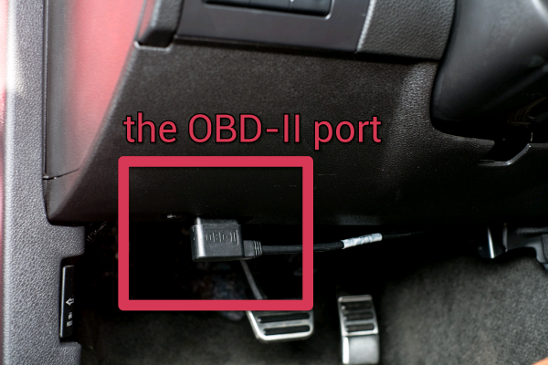
OBD port mounted near to stearing

Slide 15
AC/HVAC System

Slide 16
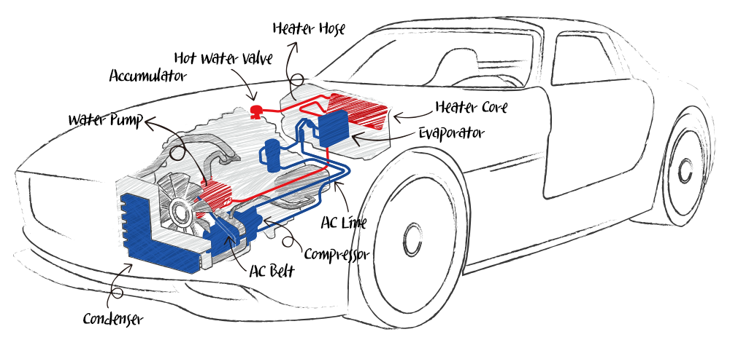

Slide 17
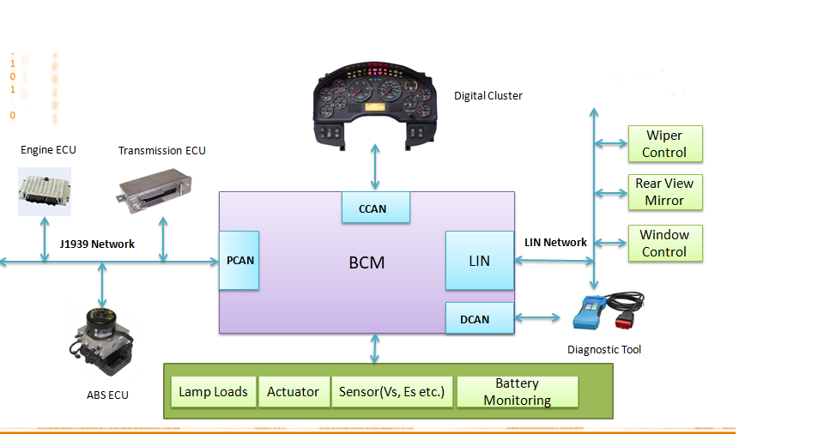

Slide 18
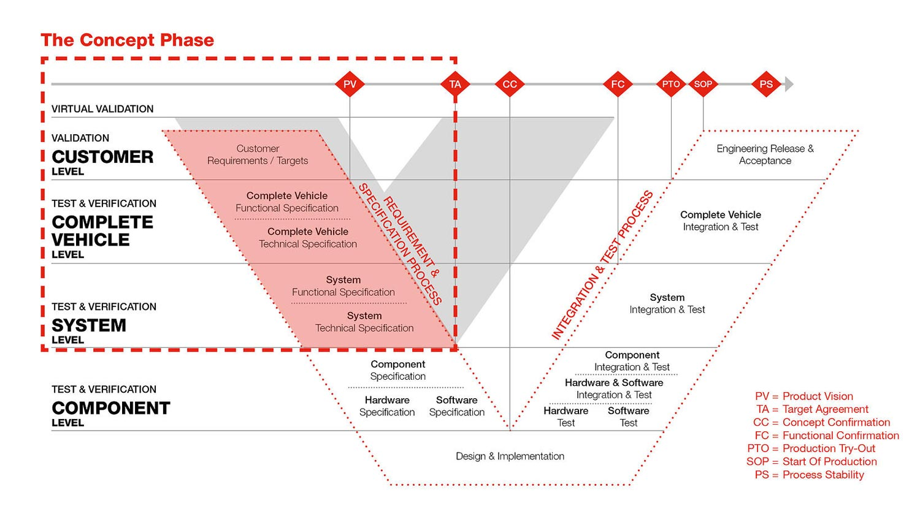

Slide 19
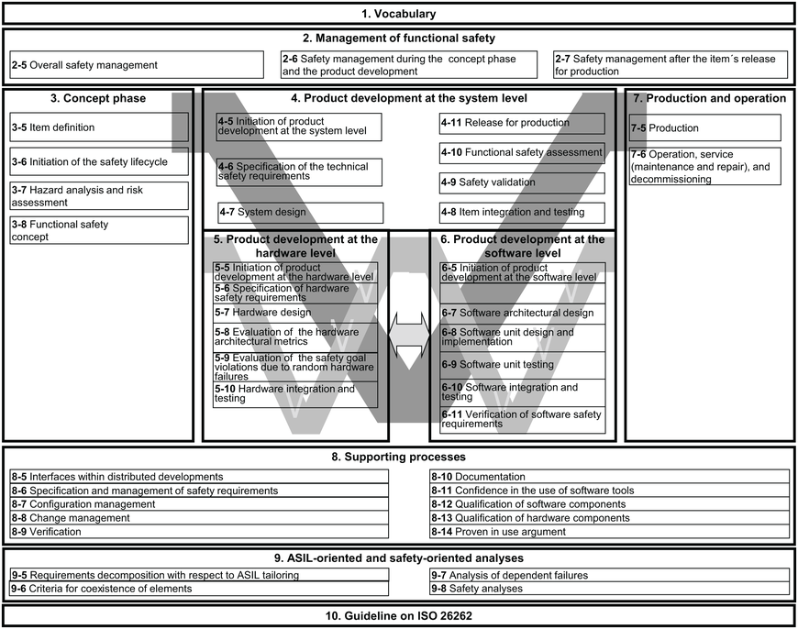

Slide 20
What is a Test Case?
Test cases are software or application pieces that you can use to test the functionality of a real system.
They can be used to evaluate the correctness and completeness of your code and can be used in conjunction with unit testing tools to ensure the quality of your applications.
Test cases can be created manually or using software testing tools.
They are an essential part of software development and should be used wherever possible to ensure the quality and functionality of your applications.

Slide 21
Test cases /Test descriptions are essential to software testing.
Test cases/Test descriptions are a set of preconditions, inputs, and expected outcomes that determine whether the software is functioning correctly.
Basically, the test cases are typically developed based on the requirements and specifications of the software application.
Test case templates typically include the test case ID, test case description, preconditions, steps, expected results, and actual results.
Writing effective test cases requires a deep understanding of the software application, its requirements, and its functionality.
Testers must be able to identify potential issues and edge cases and develop test cases that cover all possible scenarios.

Slide 22
Thank You

